Slide 1

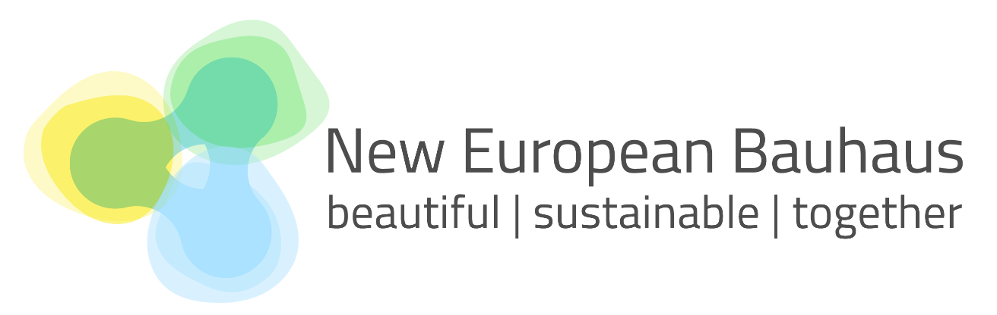

EIT Community
New European Bauhaus
Info Day

Slide 2
09:30 - 09:35
Welcome and opening remarks

Slide 3
09:35 - 09:45
EIT Community New European Bauhaus

Slide 4

EIT Community New European Bauhaus
Lead: EIT Climate-KIC
Participated: EIT Digital, EIT Food, EIT Manufacturing, EIT Urban Mobility
Natalia Vera
EIT Community NEB Manager
EIT Climate-KIC

Slide 5

NEB products and services
NEB policies
NEB behavior and ownership
Identification and support of NEB sturt-ups
NEB MakerSpaces
Identification and support of NEB citizen engagement projects
NEB Hackathons
NEB Ideation Awards
NEB Online Courses
NEB Challenges

Slide 6

EIT Community New European Bauhaus- 2021 in figures
12 NEB start-ups and scaleups acting as Pilots, identified and supported with grants and acceleration services (500K).
Lessons Learnt on NEB Pilots.
1029 start-ups and scaleups attracted by the EIT Community Booster (1000K- 20 ventures).
2 NEB online courses with 250 learners enrolled.
  Creating Ethical and Sustainable Cities at the Local Level
  Bringing Urban Nature Into the Cities of tomorrow
  2 Citizen Engagement Calls, attracting 118 applications and supporting 16 projects (425K) with dedicated site.
  12.227 participants of 2021 hackathons held by the EIT Community NEB reached through the NEB Ideation Awards.
  EIT Community NEB YouTube channel: 9,938 views, 5,200 unique viewers, 112.8 hours watch time and 91 subscribers.
10 info-sessions for EIT Community NEB opportunities.

Slide 7
09:45 – 10:30
Success Stories

Slide 8
Story 1
NEB Ideation Awards

Slide 9


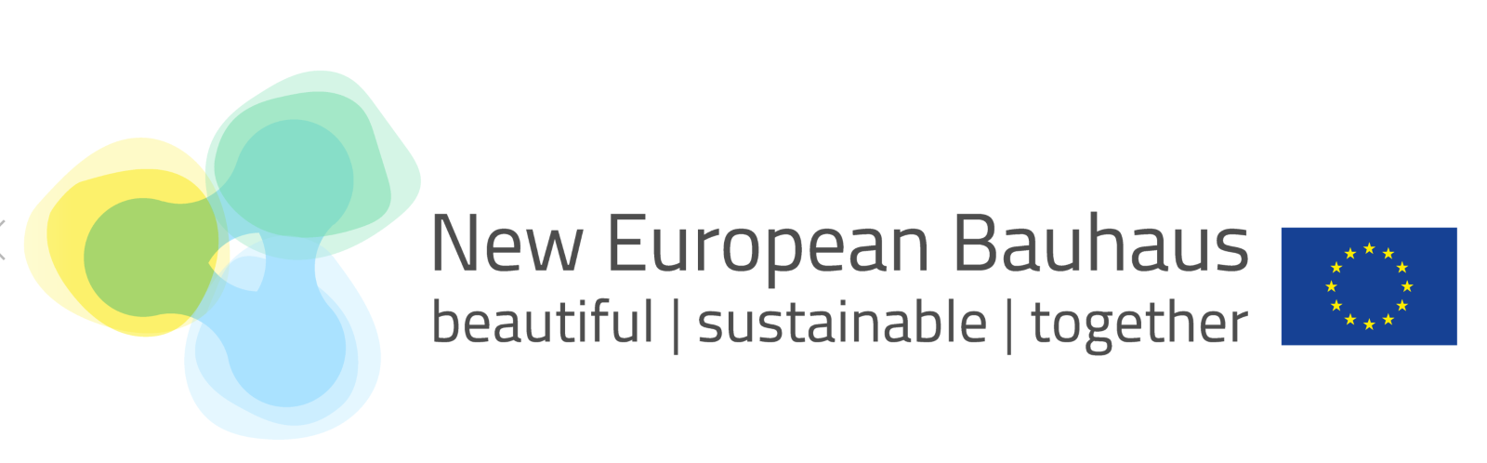

Jebbia

Slide 10

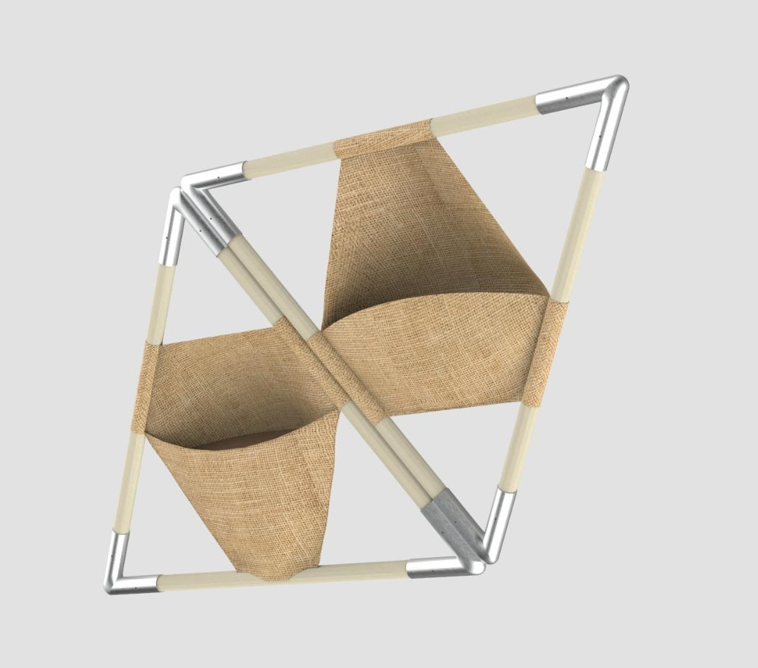
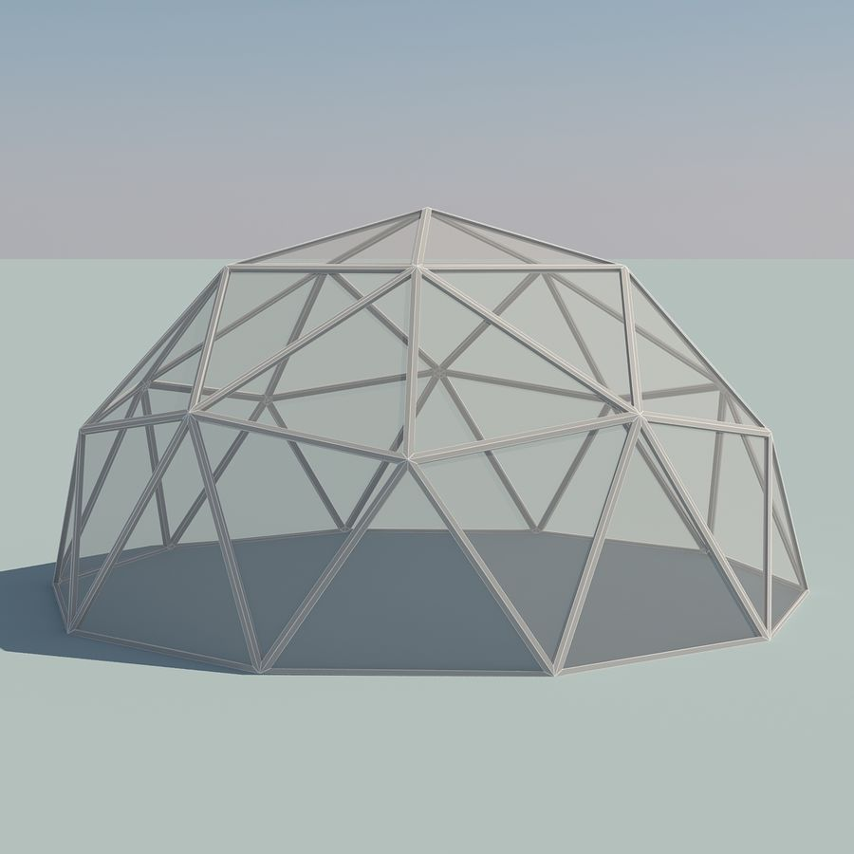




Problem:
decontextualized urban elements increase urban decay and devalue the architectural heritage
Solution:
Jebbia renovates technical spaces with a 3D green roof made with secondary raw materials
Sustainable
Customizable
Climate and architectural versatility
easy to install and maintain
Valletta, Malta

Slide 11




Aesthetics
Sustainability
Caccamo, Italy
Participating at the NEB movement will help us shed light on a problem that affects southern Europe and try to solve it with passion, love and innovation.
Inclusiveness

Slide 12
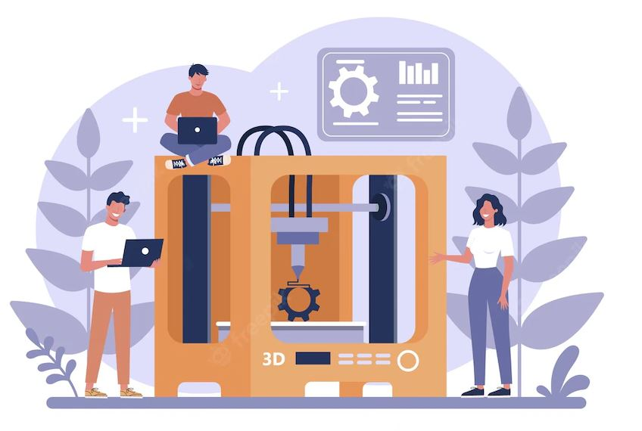

  Our project under NEB
  Completion and testing the prototype
  Get networks, partnerships and stakeholders
  Linking with industrial and operational partners
  Attracting investors and donor
  Make our cities greener together!
  info@jebbia.it

Slide 13
Story 2
NEB Start-ups

Slide 14
Workwize
EIT Digital

Slide 15
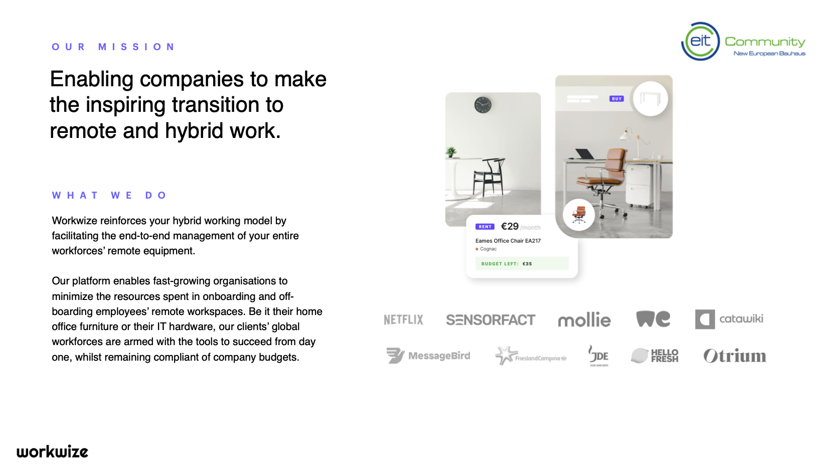

Slide 16
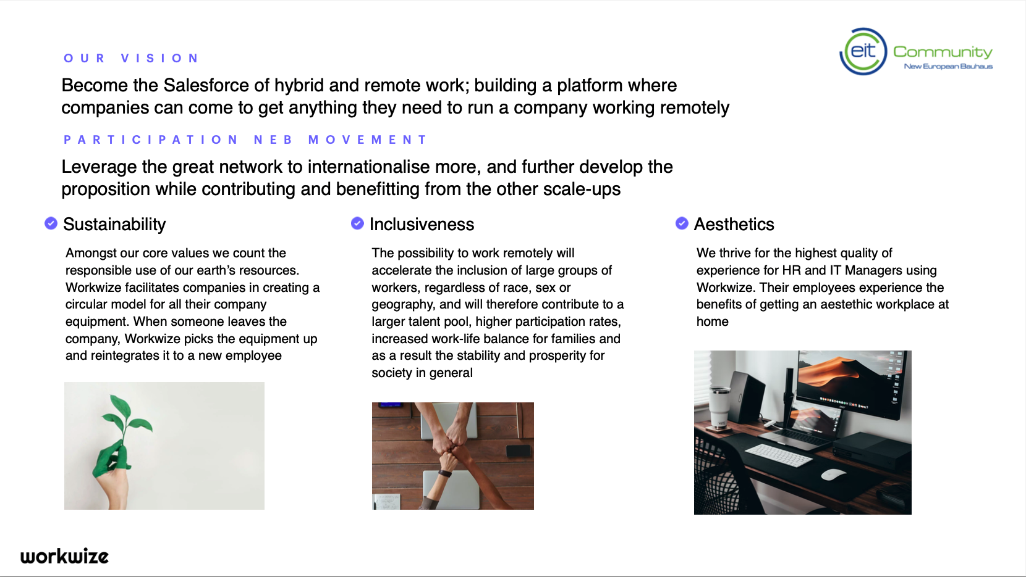

Slide 17
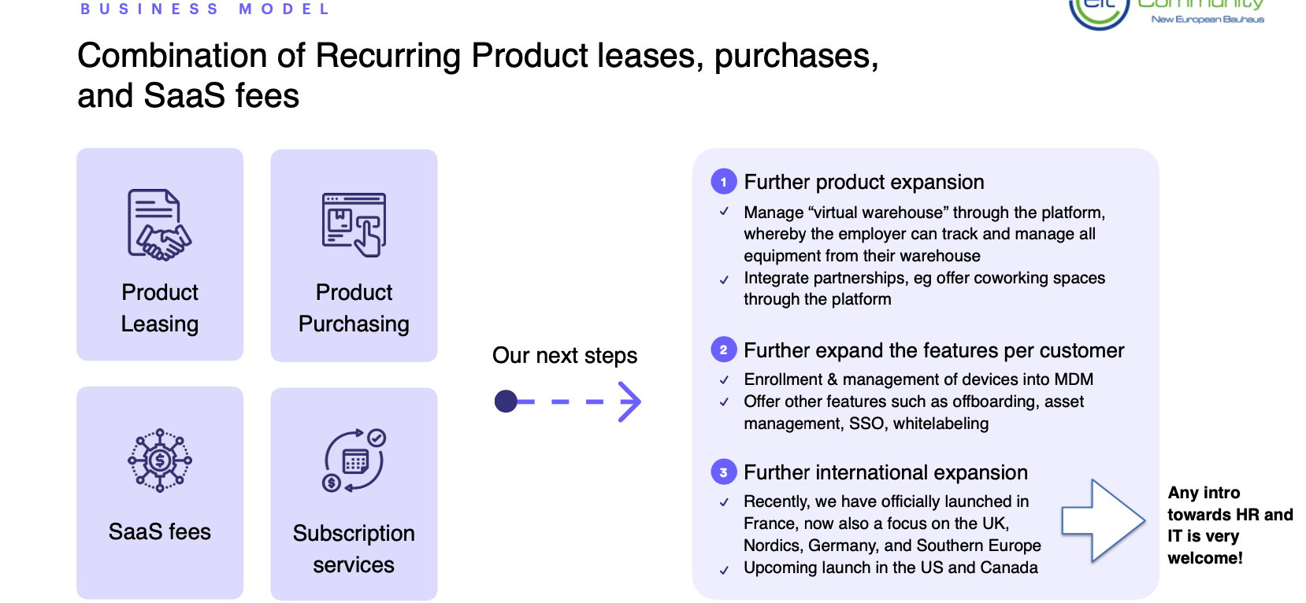

Slide 18
ScrapBees
EIT Manufacturing

Slide 19
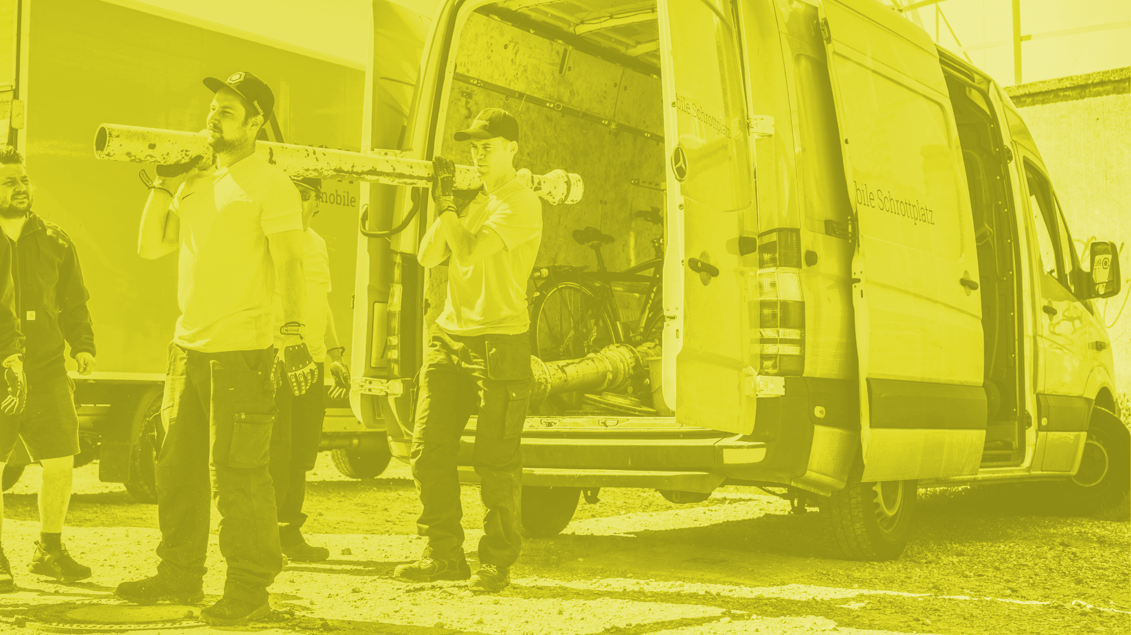

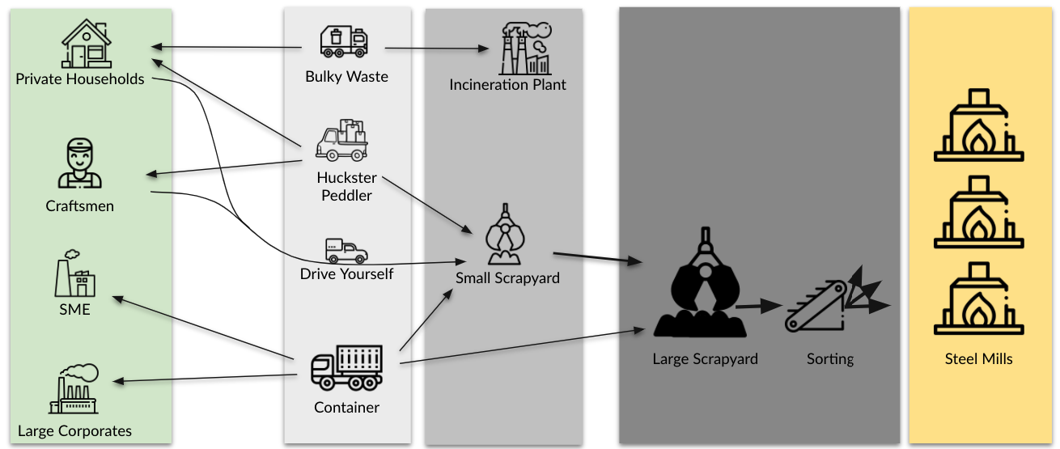
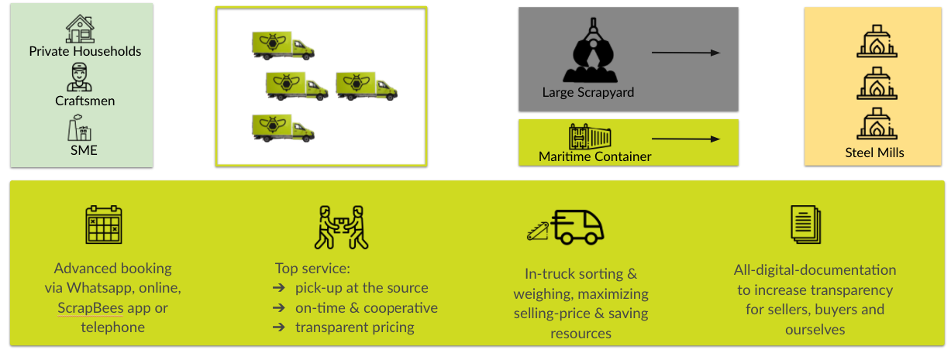
We transform society
by accessing the untapped urban mines
1
Where’s the core problem with scrap collection?
Producers of large amounts of scrap metal, such as large businesses, can profitably transport and sell their scrap to metal mills in volume.
But producers of small amounts of scrap metal, such as households, craftsmen and small businesses have no easy way to get rid of scrap, and once they do, this scrap is often not properly sorted and recycled, ending up in incinerators instead.
2
ScrapBees is connecting untapped urban miners with metal producers.
Instead of mixing metal scrap in containers we collect and sort metals at source, thereby maximizing the selling-price & saving resources. We are digitally documenting all steps to increase transparency for sellers, buyers (Scrap Yards & Steel Mils) and ourselves. Our tech-driven, on-demand pick-up service shortens the value chain and allows Steel Producers to source raw materials locally and display their Scope3 emissions.
TRACTION: 13 BeeVans (Rhein, Ruhr, Saxony) // 33 Jobs created // Proprietory Software solution in use // 4.600+ pickups completed //
1.000+ tons recycled material // >150 B2B customers

Slide 20
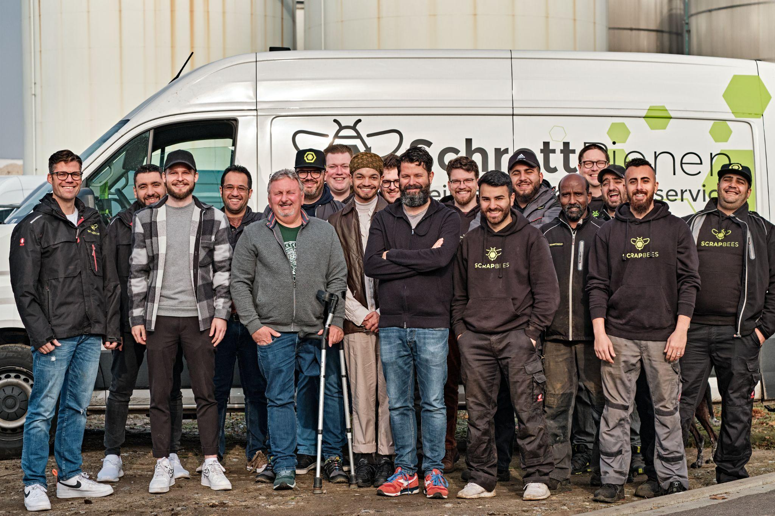



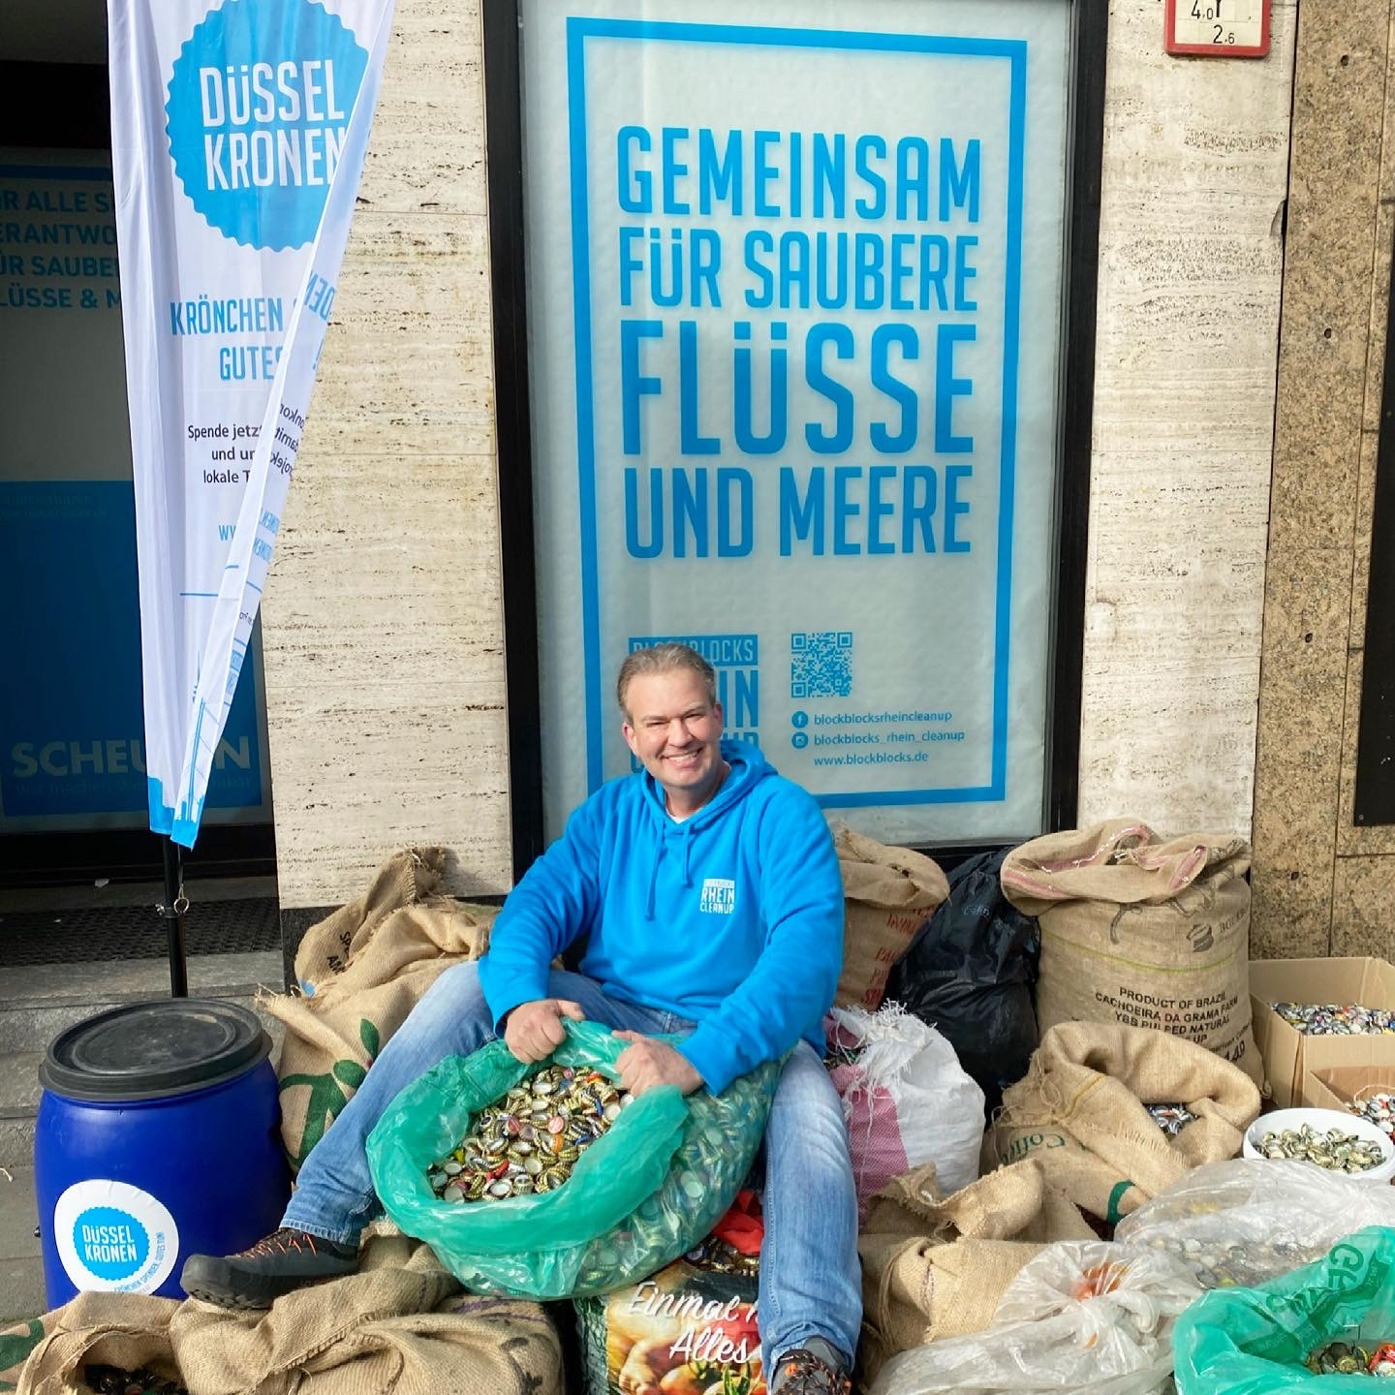
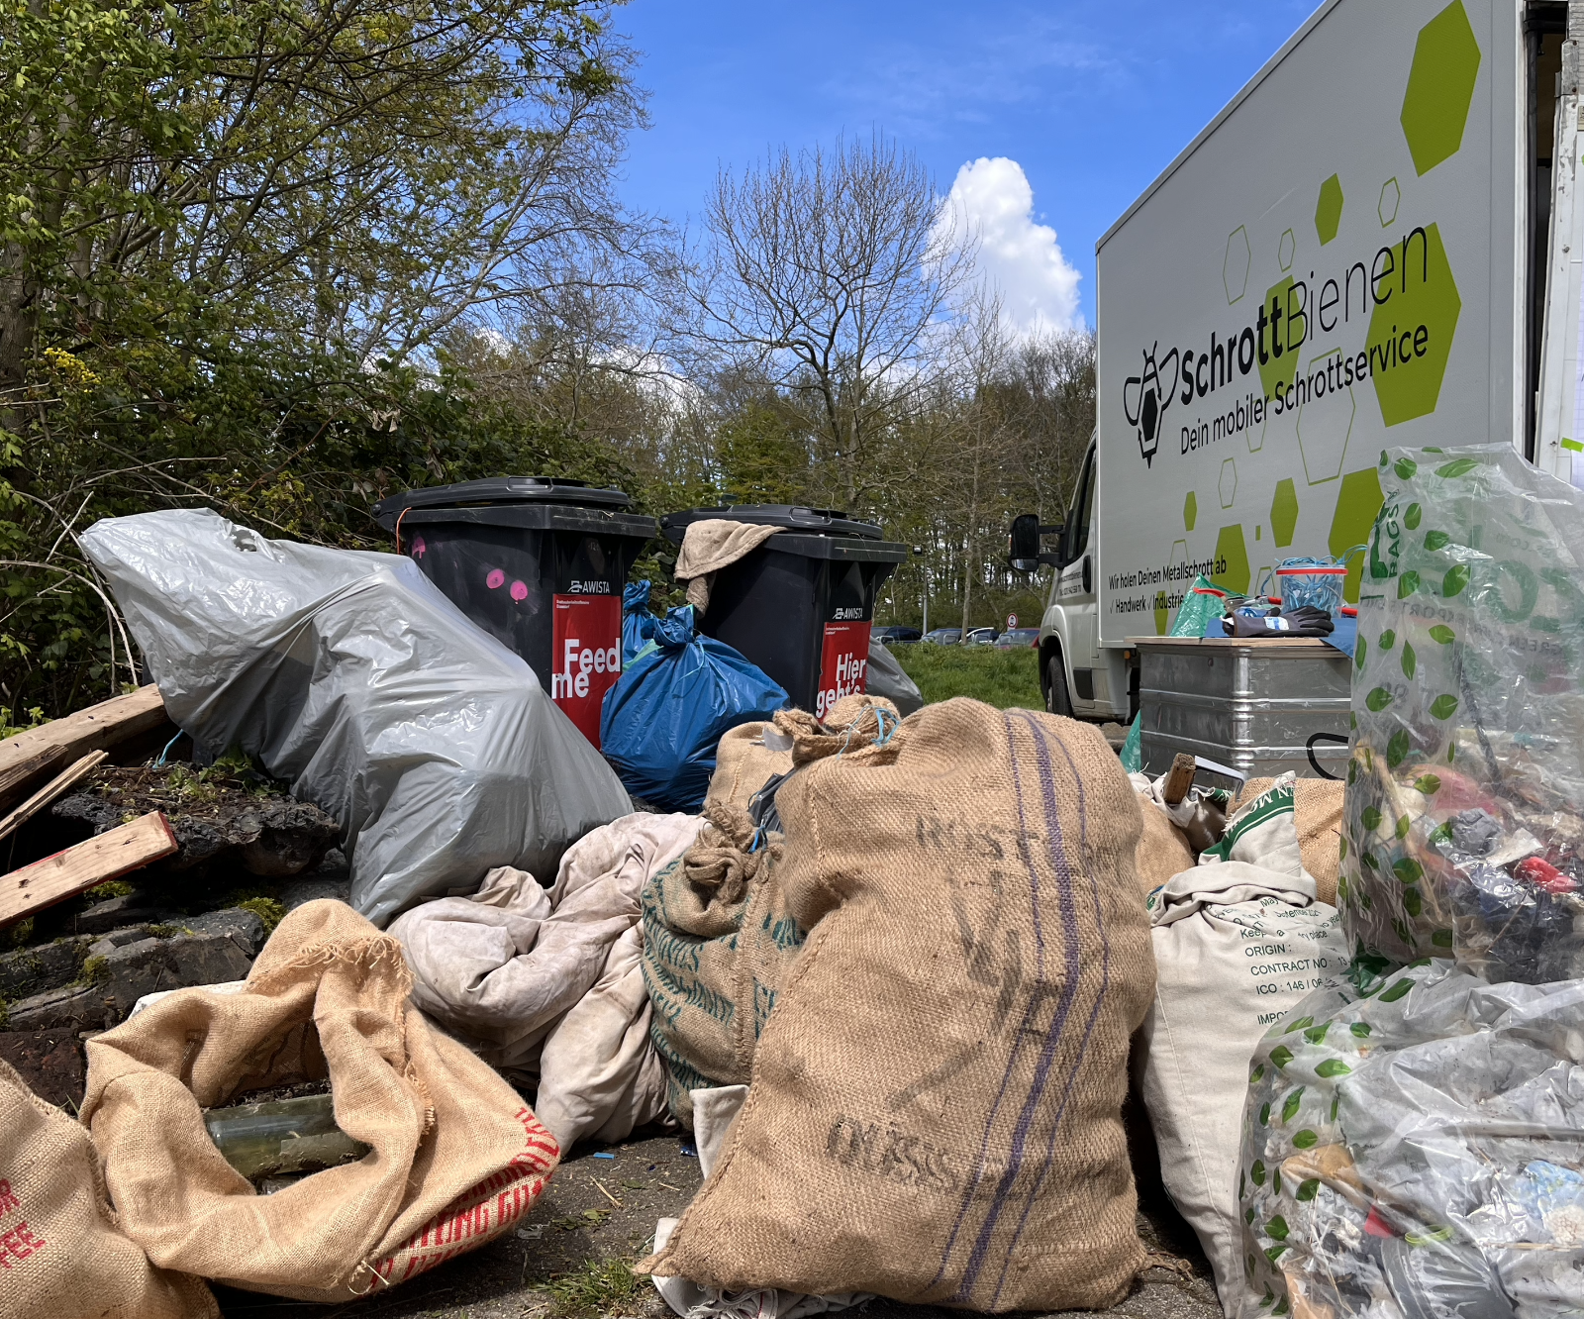
ScrapBees & NEB Core Values
sustainability
inclusiveness
aesthetics
Every kilogram of scrap metal we recycle is equal to 1,000+ kilograms of raw ore that must be removed from natural land, transported, processed, and refined.
We’ve recycled more than a thousand tons in the last 12 months.
We in our company attach great importance to the inclusion of socially marginalized groups. We welcome everyone who can identify with our vision - regardless of gender, ethnicity, nationality or social affiliation. Our 33 Team members stand for 10 different nationalities.
We transform waste into a tradable commodity so it no longer needs to be thrown away. Instead we create a raw material for new products. To achieve that we cooperate with NGOs like “Rhine Clean Up” to access these urban mines and help clean our cities & rivers at the same time.
We transform society by accessing the untapped urban mines.
We are obsessed to bring our customers tech-driven, on-demand pick-up in a simple and convenient way.

Slide 21




Next Steps
Business Model
On-demand electronic booking 1-7 days in advance.
ScrapBees driver-app for scheduling, navigation and documentation of the collected materials.
Regional growth
  Germany (->2022/23)
  Europe (2022/23->)
Strengthen B2B fokus
Deliver maritime containers directly to steel mills
  cutting out parts of the value chain
  enabling steel mills to show scope 3 emissions
Accelerated growth via industry
multipliers
Capture further Customer
Segments/Verticals
Selling of the sorted metals to specialised scrapyards. By aggregating small lots, we achieve better prices than local competition (yield per kg increases with volume).
Material value is realised and multiplied by aggregating the pure metal types
2023
2023
We are being paid from both sides - the scrapyard values perfectly sorted and larger quantities of material, the (b2b-)customer gladly pays a small fee for perfect service to get the waste removed.
Non-ferrous material is refunded by credit note, ferrous material is not refunded.
2022
2023
2021
2023
2022
2022
2022
2022
2022
2021/22

Slide 22
VePa – Vertical Parking
EIT Urban Mobility

Slide 23
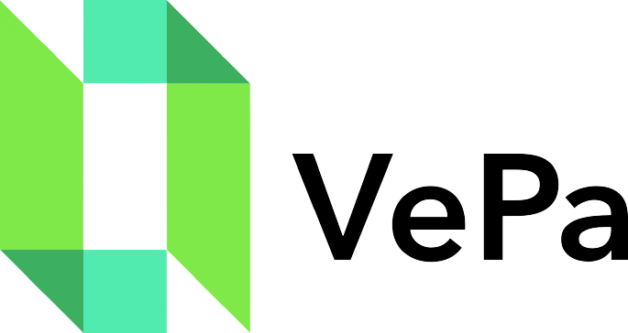
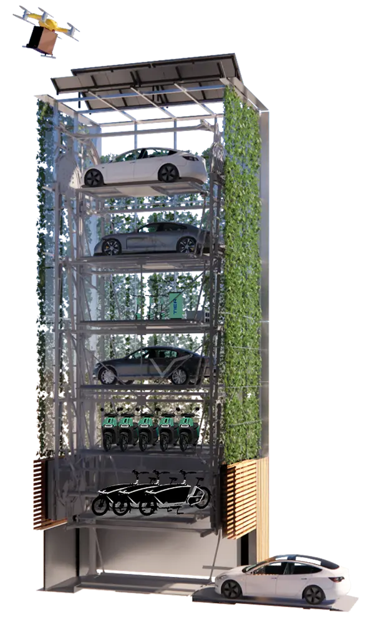
VePa – Vertical Parking
We offer you a sustainable parking solution and can be a building block in how you can create more living space in a sustainable and innovative way.
let's rethink parking
We have developed vertical parking towers that enable you to solve the parking space problem of your real estate projects in a simple, space-saving and sustainable way. With VePa you can fully exploit the potential usable floor space of your properties. Eventually, you contribute to achieving climate targets and create needed living space.

Slide 24
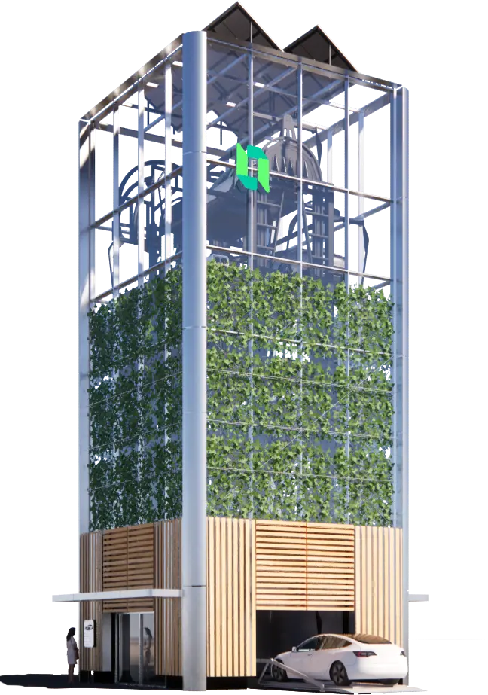
VePa – Vertical Parking
Space-saving
12 parking spots on the space requirements of two parking spots
Sustainable
A 66% lower CO2 footprint
Flexible
Assembly and disassembly in only 5 days
Aesthetics – We feel the picture tells the story.
Inclusiveness – Including not excluding parking as part of future urban mobility.

Slide 25
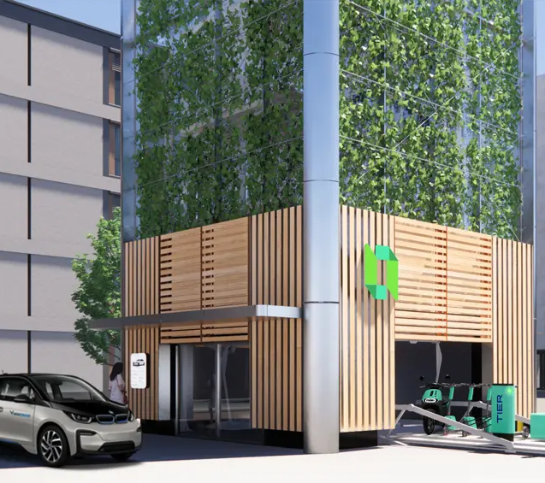
Vepa – Vertical Parking
What does your business model work like?
Not least due to the mentoring from EITUM we have transformed our tower from being parking of cars, to being a traffic hub for many types of vehicles. Included charging. And a greener visual.
What are your next steps?
We just sold out first tower, and are very close to closing additional 3-4 towers.
This gives us a financial position, where we can start to offer also leasing and rental.
So next steps are sales – scaling!

Slide 26



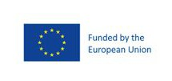
inoqo GmbH
EIT FOOD ACCELERATOR PROGRAMME

Slide 27
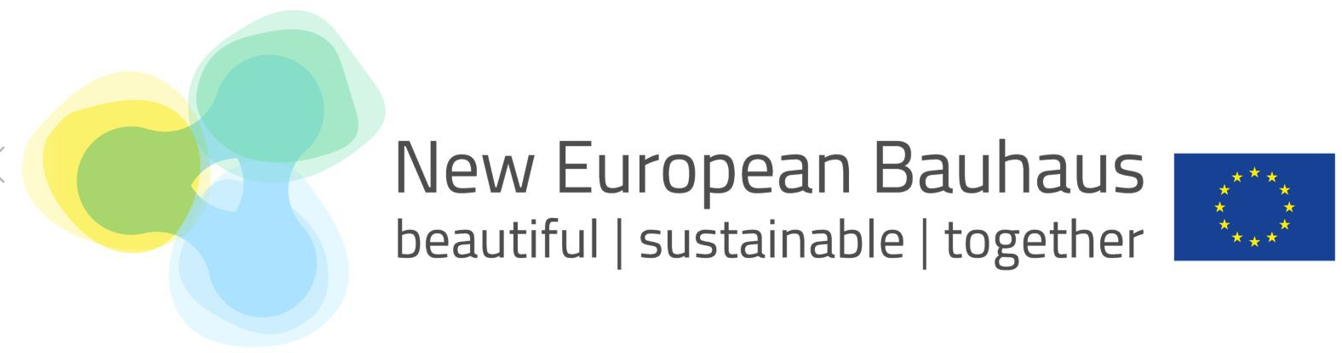


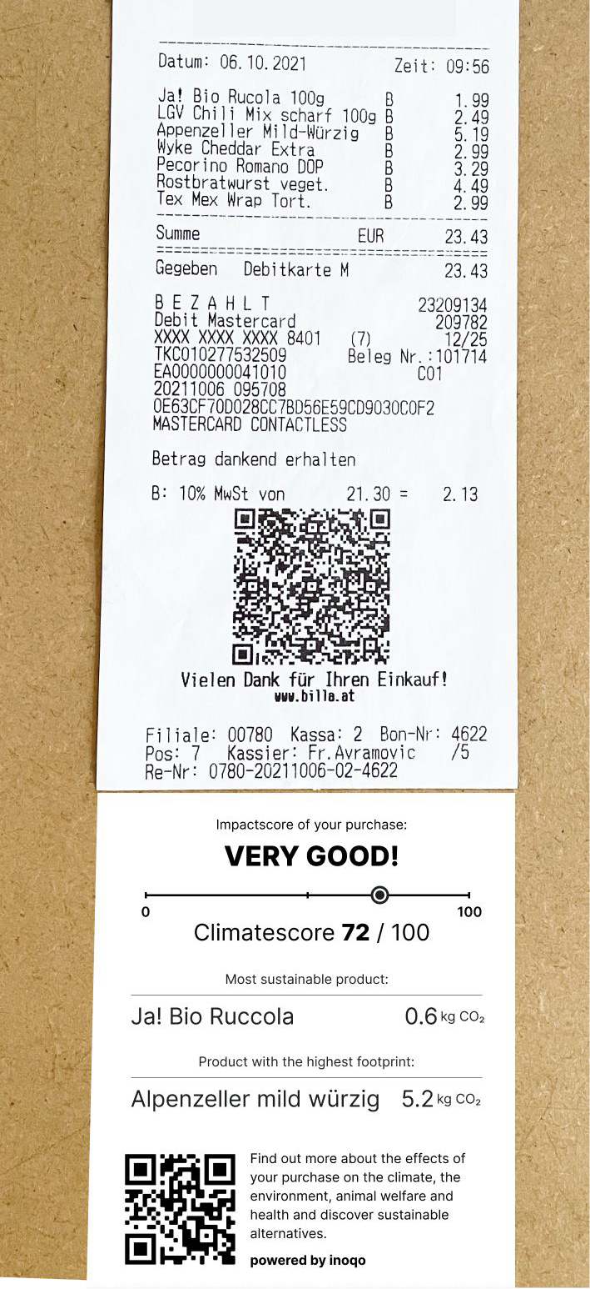
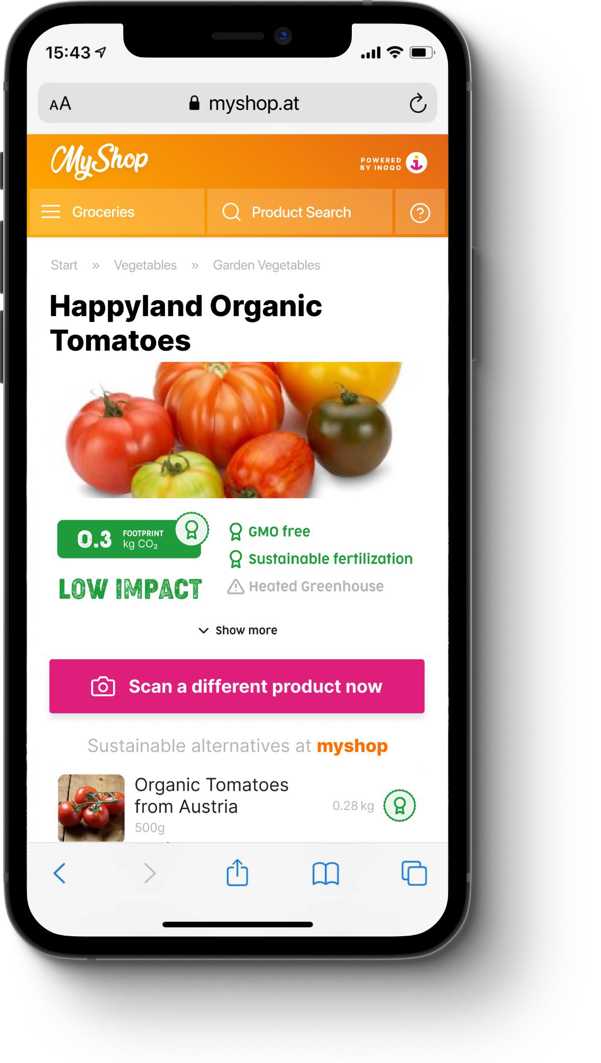
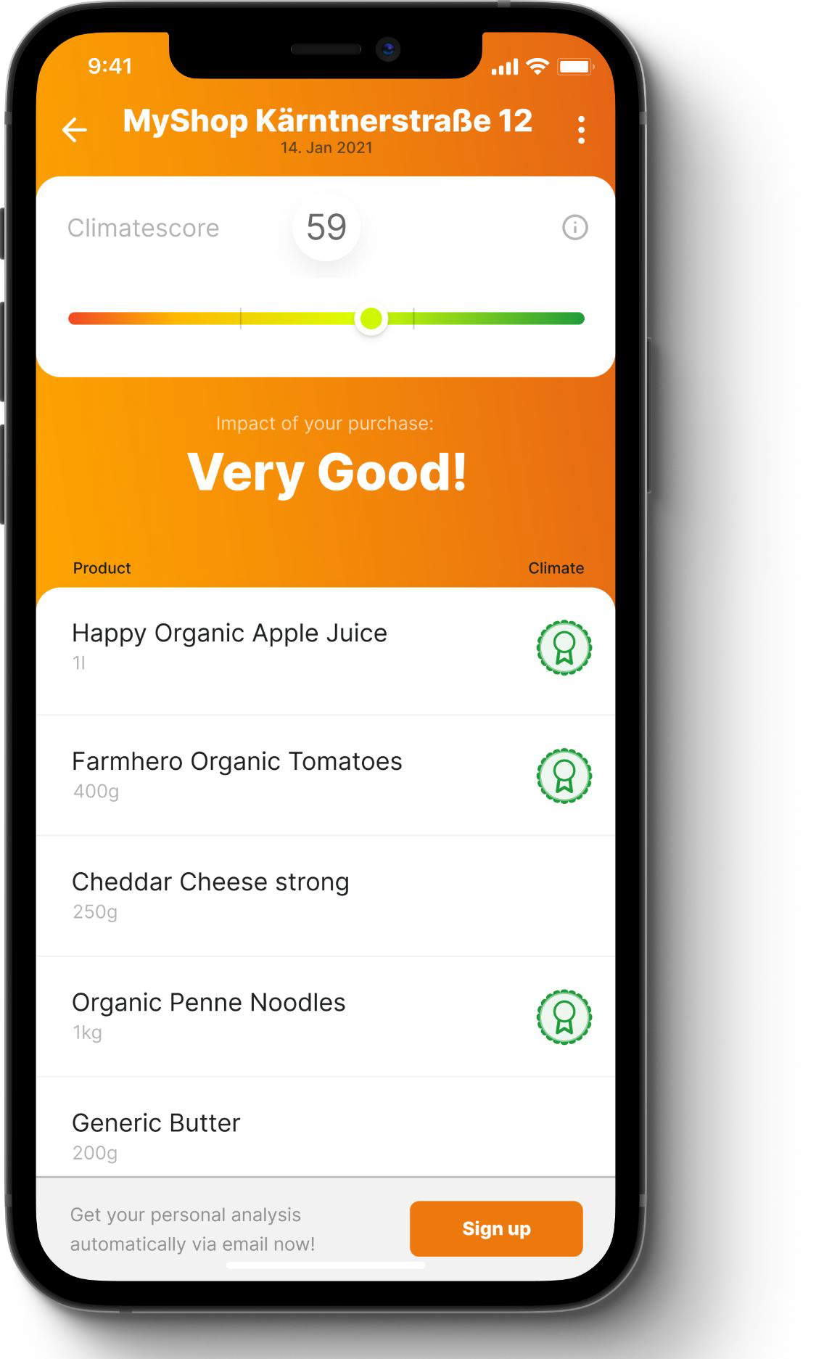
About inoqo
With inoqo, we enable grocery retailers to provide their customers with rich insights on the Product Environmental Footprint (PEF) of thousands of F&B products at the POS, as well as support consumers with our mobile app to transition towards a healthier and more sustainable diet

Slide 28
NEB Alignment
-Contribution to a sustainable transition towards a climate neutral economy by 2050
-Fostering citizens' behavioural change towards low-carbon and climate-resilient food diets
- Aiming to digitally scale-up food labelling in Europe with nutritional, climate, and social aspects
-Promoting the uptake of renewable and circular bio-based food packaging
Our vision
Our vision is to revive the wellbeing of our planet and people by accelerating the shift towards more
sustainable consumption and production patterns.

Slide 29
Our business model and roadmap
inoqo retail solution (B2B)
Entailing PEF calculations covering retailers’ entire product assortment to create a sustainability engagement solution through which retailers can become their customers’ partner on their way to a more sustainable lifestyle
Performance Based Marketing (B2C Consumer App)
Sustainable brands can target consumer micro-segments with coupons, ads & sponsored content
Q3’22
GoLive of first retail solution
Q2’ 23
Launch in Germany
‘23
Launch of U.K., Europe (North and West)
01
02
03
04
05
05
Q4 ’22
Market Launch
B2C in test market Austria
‘23
Launch of new business segments: FMCG, fashion, mobility
‘25
150 new retail
opportunities in the EMEA & NA region

Slide 30
Story 3
NEB Citizen Engagement

Slide 31
FURNISH
EIT Urban Mobility

Slide 32
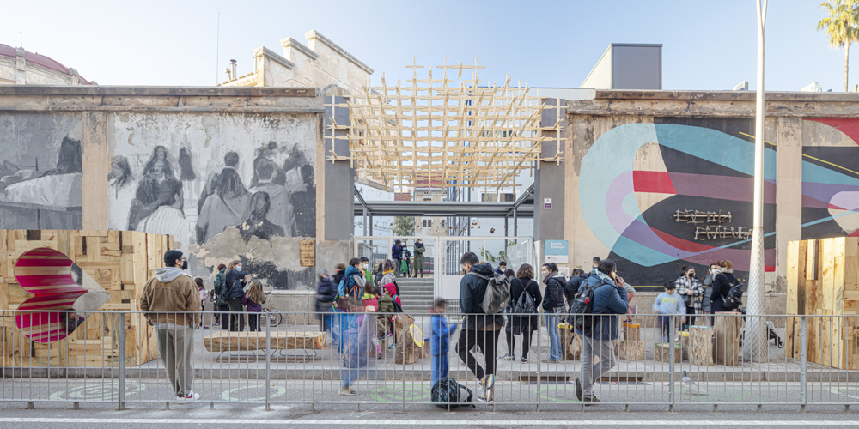


LET’S PROTECT THE SCHOOLS
Ajuntament de Barcelona
2 SCHOOLS:
Escola Entença
Escola Antoni Brusí
KEY WORDS:
PEDESTRIANISATION
CONNECTION
PLAYGROUNDS
ACTIVITY
COMMUNITY
PARTICIPATORY PROCESS
CO-CREATION
IMPACT ASSESSMENT
SOCIAL EVALUATION
FURNISH 2021
New European Bauhaus
FURNISH 2021 CITY: Barcelona
SCHOOLS: Escola Entença / Escola Antoni Brusí
TEAMS: IAAC Team / Elisava Team
Image: IAAC Team

Slide 33
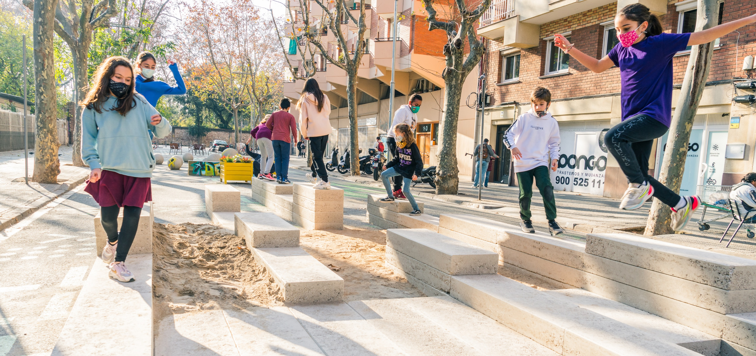
LET’S PROTECT THE SCHOOLS
Ajuntament de Barcelona
Sustainability
Natural materials
Inclusiveness
Children – Community – Schools – Co-creation
Aesthetics
Innovative co-design
FURNISH 2021
New European Bauhaus
FURNISH 2021 CITY: Barcelona
SCHOOLS: Escola Entença / Escola Antoni Brusí
TEAMS: IAAC Team / Elisava Team
Image: Elisava Team

Slide 34
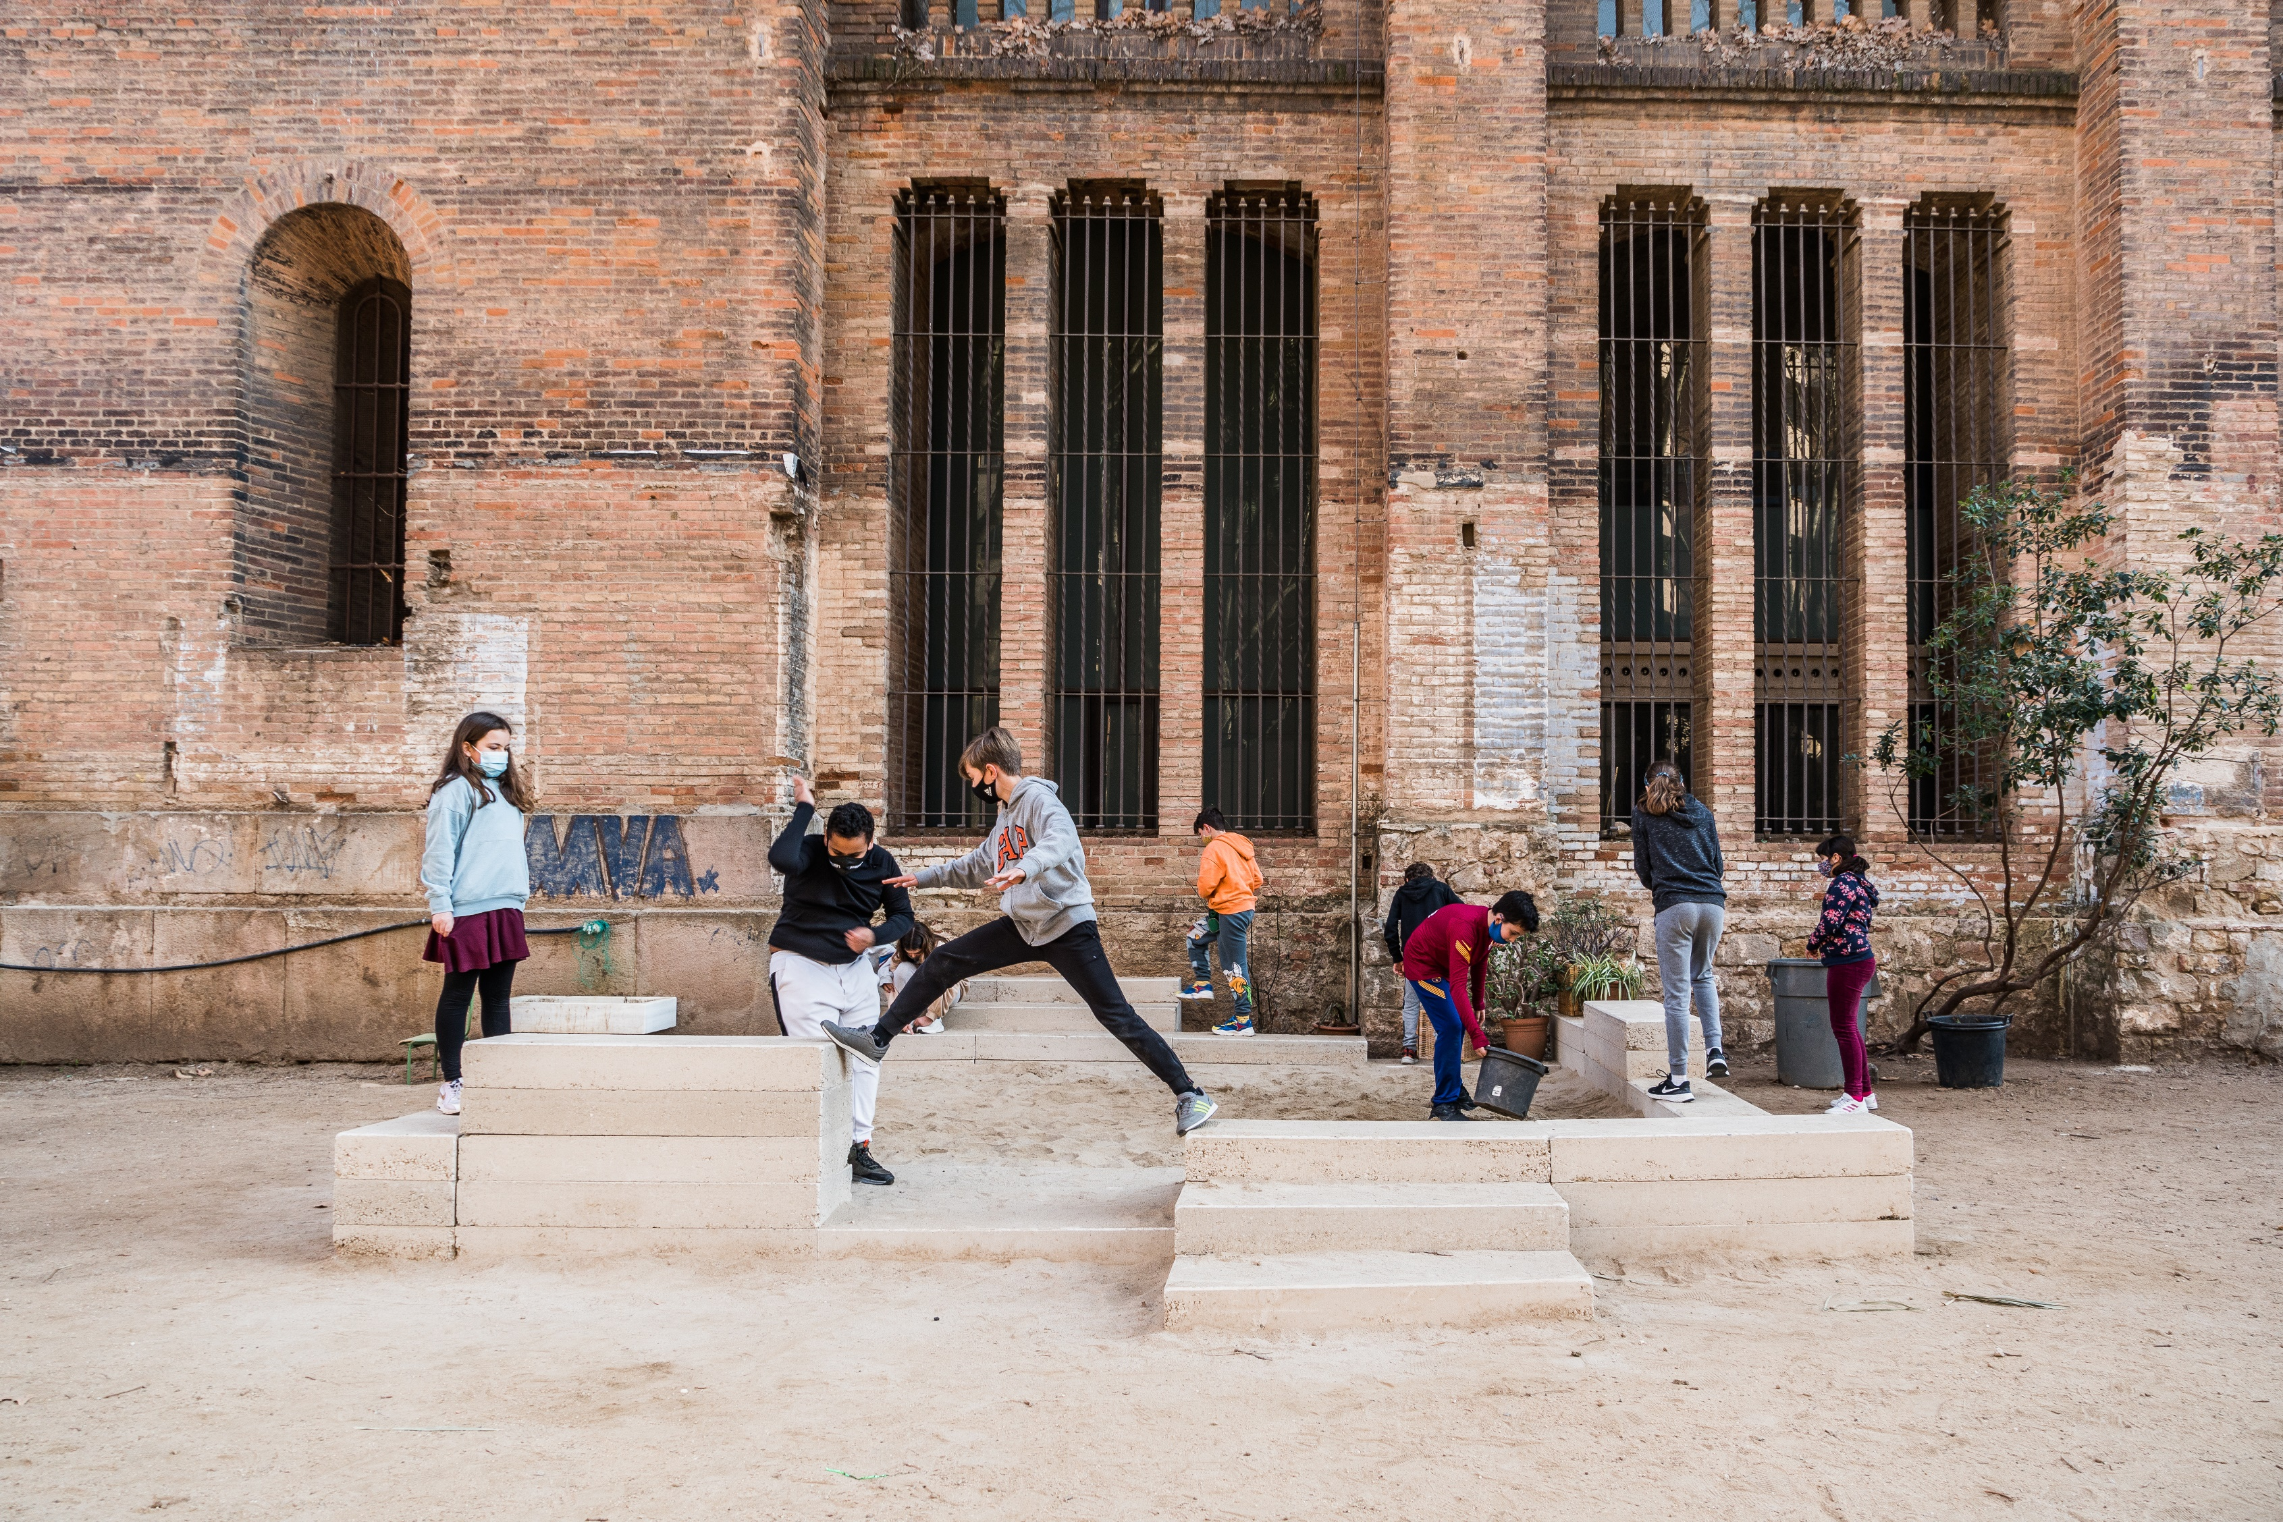
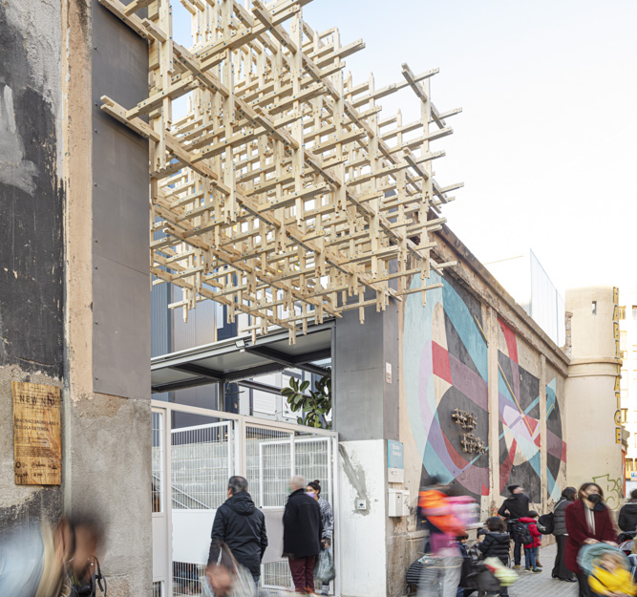
PEDESTRIANISATION
CONNECTION
ACTIVITY
COMMUNITY
PARTICIPATORY PROCESS
CO-CREATION
SOCIAL EVALUATION
FURNISH 2021
New European Bauhaus
FURNISH 2021 CITY: Barcelona
SCHOOLS: Escola Entença / Escola Antoni Brusí
TEAMS: IAAC Team / Elisava Team
Image: IAAC Team
Image: Elisava Team

Slide 35

CLIME - transgenerational AR climate voyage through time and space
powered by Impact House, City of Pula, Gamechuck and Terra Hub (Croatia)
CROSS-KIC NEW EUROPEAN BAUHAUS CALL FOR REGIONS, CITIES OR AFFILIATED ENTITIES: CAPITALISING ON EXISTING PUBLIC REALM SOLUTIONS

Slide 36
CLIME - stories about climate change in Pula (Croatia)
The CLIME brings together narratives about climate change and the way of living in Pula spanning through 90 years and several topics such as resources, waste, transport etc.
The main goal of the project “Clime” was to connect generations in a common goal of tackling climate change by using AR technology to share an experience that stretches over the lifetime of elderly citizens and benefit from their strategies of living in rapid climate change.
How?
Anthropological research among the elderly residents of the city of Pula who shared their experiences and stories
Based on the collected stories and qualitative analysis of the data, we have created a map of Pula and the “CLIME” AR mobile app (over 100 interactive dialogues compiled into AR app, enables you to ask questions and get answers in real-time while walking around the ancient city) as well as a database for researchers
Notes:
CLIME AR Showcase Video - YouTube

Slide 37
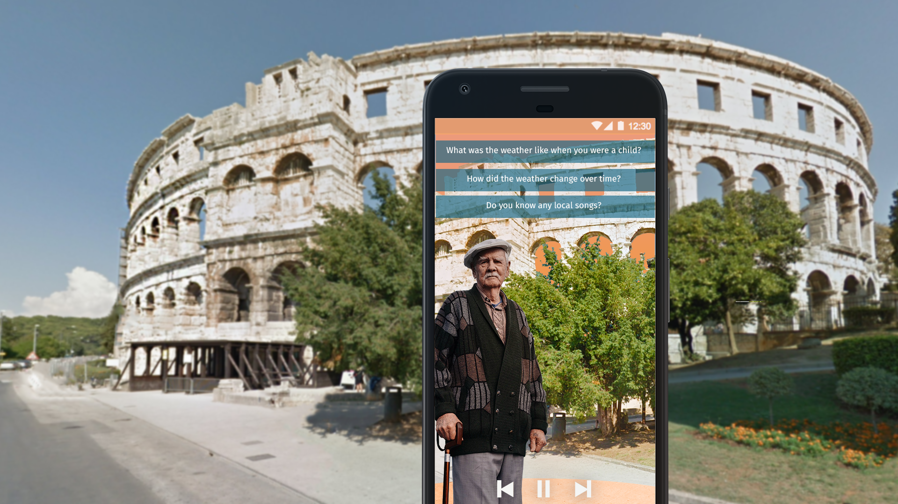
Our and NEB Values and Goals:
Reviving ‘Councils of Elders’ connection with Youth
Archiving and researching collective memory of climate change and the way it affects lives, architecture, food, work, travel, tourism.
Strategic use of Heritage and Culture for planning and restoring connection in public space
Using new technologies (AR) to connect generations, spaces, heritage, nature and narratives
Supporting and innovating domestic and international social impact tourism
  *scaling - room to action

Slide 38
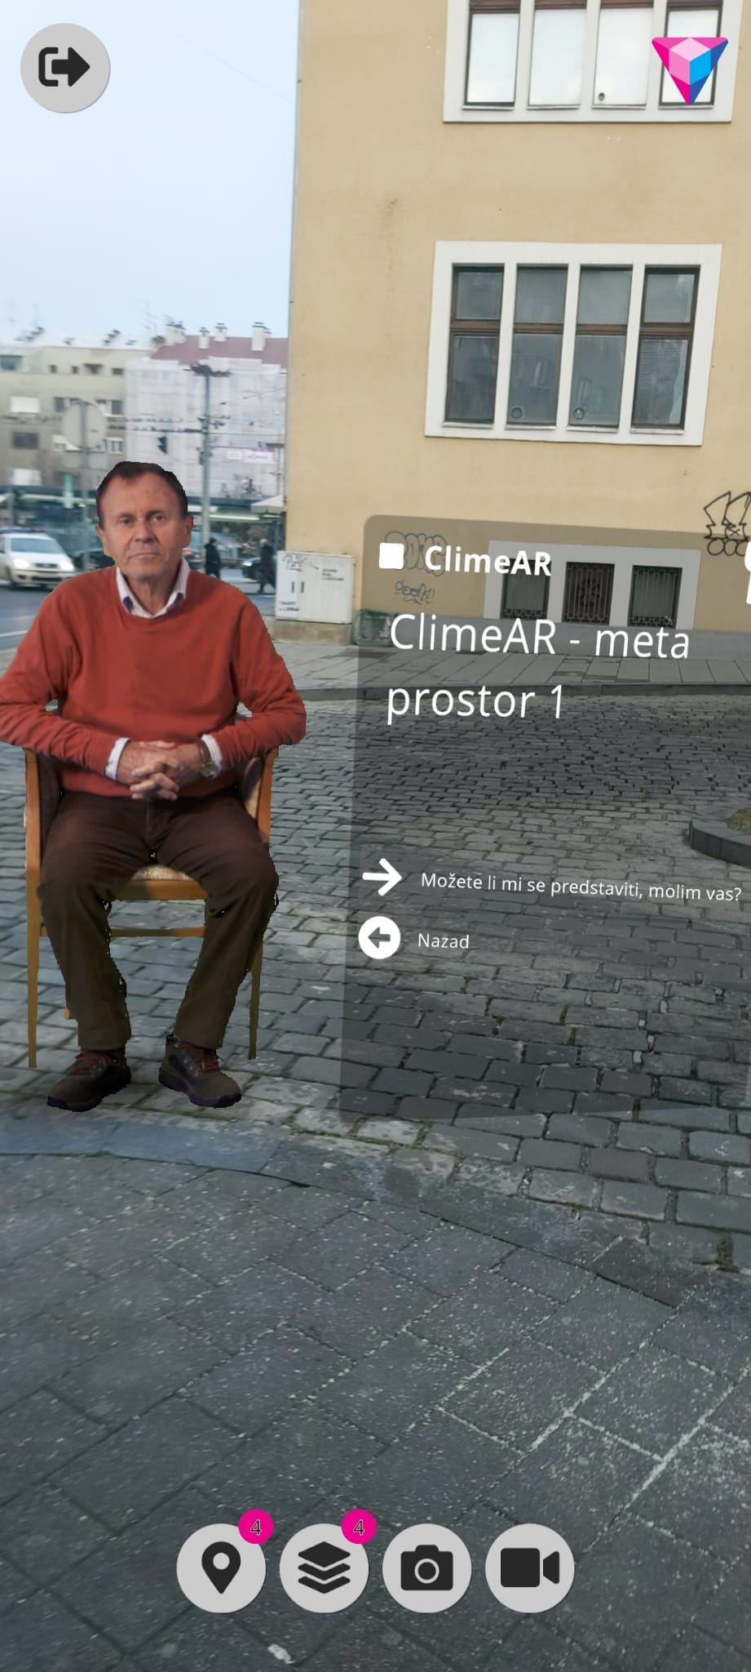
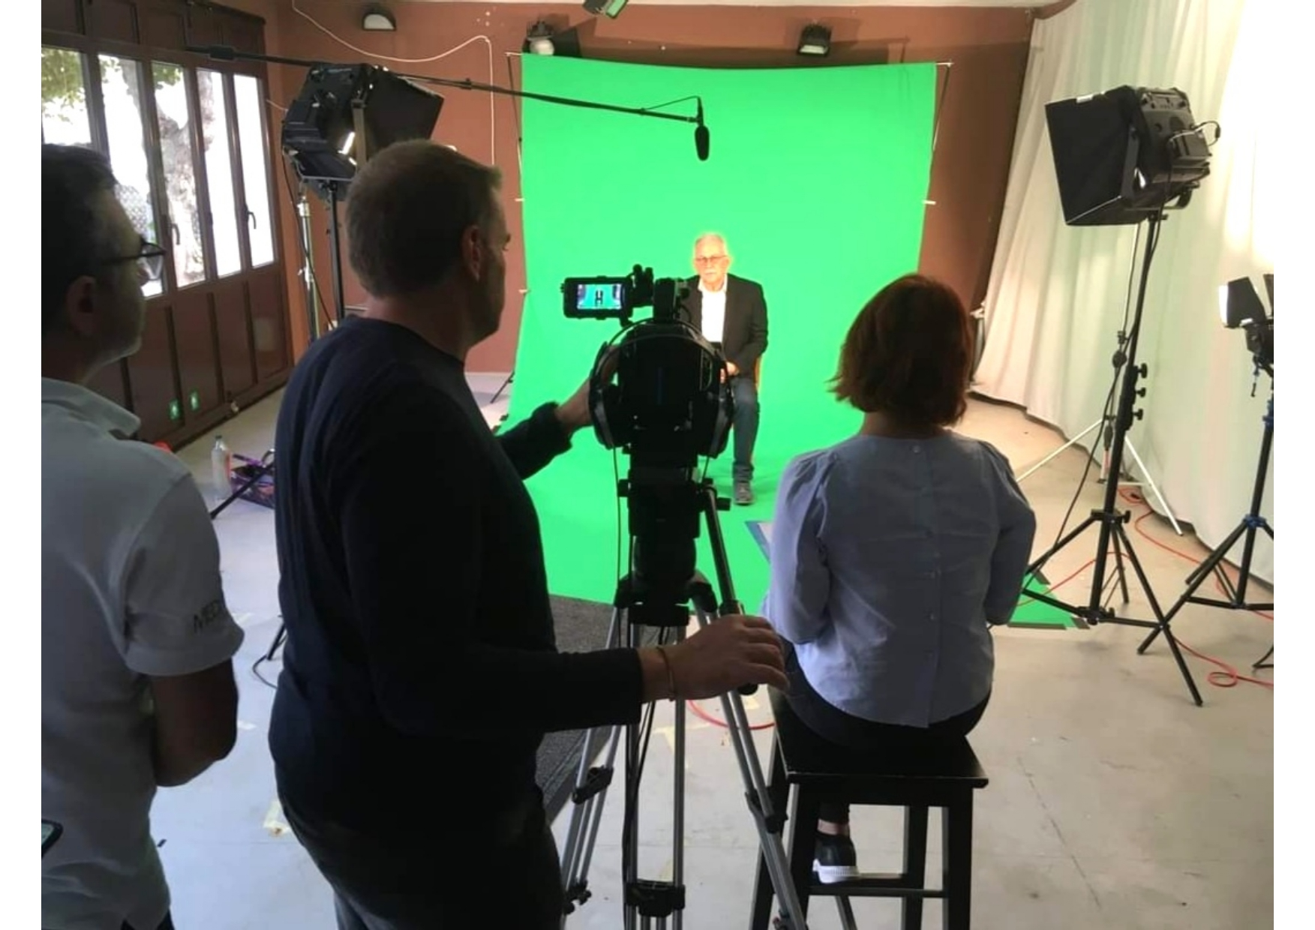
Interviews with elders - anthropological research
AR Mobile App

Slide 39




LA CUCINA COLLABORATIVA
(The Collaborative Kitchen)
EIT FOOD

Slide 40
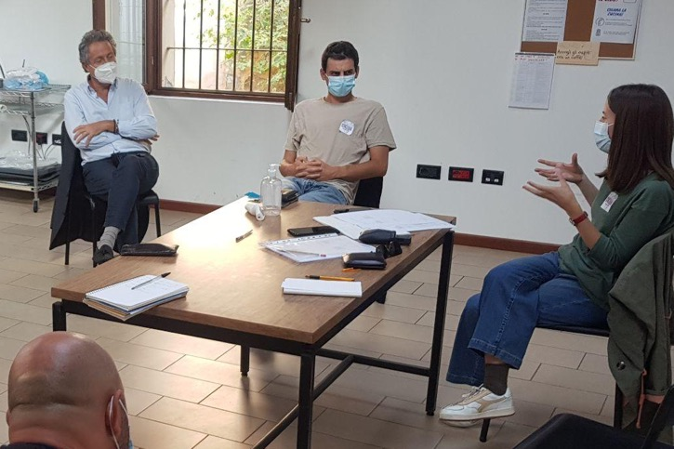
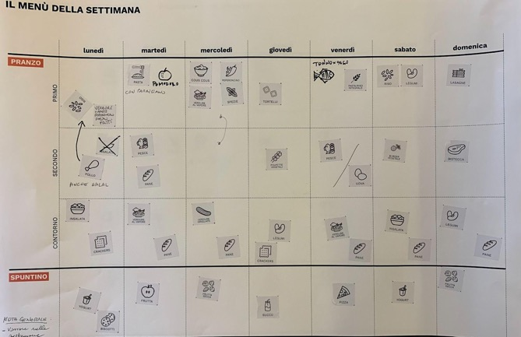
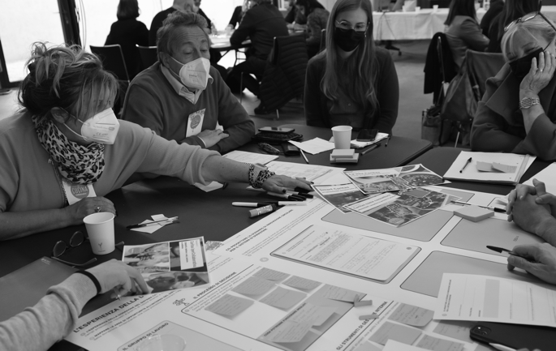
MAP THE SYSTEM
EXPERIENCES
NEEDS
SCENARIOS
IDEAS
UNDERSTAND
THE SYSTEM
LISTENING
WORKSHOP 1
Diners and volunteers
WORKSHOP 2
Food donors
WORKSHOP 3
City stakeholders
PROTOTYPING/
RAPID SIMULATION
PRE-ENGAGEMENT
CO-CREATION

Slide 41
Inclusiveness
Working with those who are most disadvantaged
Aesthetics
Challenging the logics of food donation
Sustainability
Circularity by default

Slide 42
We want to innovate urban food aid systems to change the way meals and food packages are managed, composed and delivered, creating the possibility for disadvantaged groups to afford healthy, personalised nutrition.
Recognising the importance of the climate transition, we want to ensure these new urban food aid systems are sustainable by promoting an inclusive and circular approach to food donation and public health, through open collaboration and the use of distributed and digital technologies, and data analytics.

Slide 43
10:30 - 10:45
Coffee Break

Slide 44
10:45 – 11.15
Break-out rooms

Slide 45
11:15 - 11:30
New European Bauhaus
Opportunities in 2022

Slide 46
11:30 - 12:00
Q&A

Slide 47
EIT Community New European Bauhaus- 2022 upcoming opportunities!
EIT Community New European Bauhaus Call for proposals for Citizen Engagement Activities
Budget: 120K total investment- 15K per project proposal
Info session: 26th April, recorded session available
EIT Community New European Bauhaus Call for Co-Creation of public space through citizen engagement
Budget: 270K total investment- 45K per project proposal
Info session: 26th April, recorded session available
Call for Partners: 2022 New European Bauhaus Hackathon Week Organizing Partners
  Budget: 180K, 30K per host
  Info session: 16th May
Call 2022 New European Bauhaus Ideation Awards
Award prizes of 10K to 5 best proposals. 5 Award categories, one per NEB axis, plus NEB for peace. Total: 50K
Announcement early June at the NEB Festival
EIT Community Booster- Scaling Up New European Bauhaus Ventures
Budget: 1000K, 50K per start-up.
October-November

Slide 48
EIT Community New European Bauhaus- 2022 events and other opportunities!
EIT Community New European Bauhaus at the New European Bauhaus Festival
Brussels, 9th June. Venue and time TBC. Remarkable Chair and Key-note speaker
    Winners of Jury Prize + Winner of Audience Award. Grand Jury Award live announcement!
    Citizen Engagement successful stories
New European Bauhaus Online Courses
  “Introduction to NEB”
    Target group: public in general
    Aim: broad raising of NEB awareness- NEB ownership
  “The need for long term, life cycle and integrated thinking in the industrial ecosystem”
  “Re-gaining sense of belonging”
  “Prioritising the places and people that need it the most”
Target group: public in general and businesses, specific chapters for civil and public servants, public authorities and public decision-makers
Aim: to insert the NEB in public policies and private processes
New European Bauhaus Hackathon Week
Last week of September. Teams eligible to 2022 New European Bauhaus Ideation Awards
EIT Community New European Bauhaus Day at InnovEIT
23rd September, Berlin. Policy discussions and real life New European Bauhaus stories
EIT Community New European Bauhaus MakerSpaces Network

Slide 49
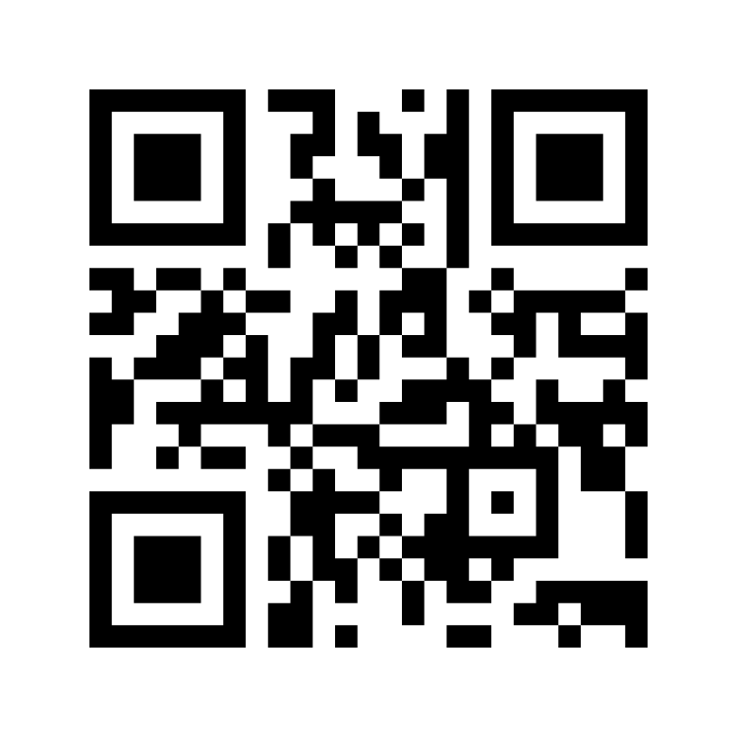
Join us on Menti.com
2491 5435

